Slide 1

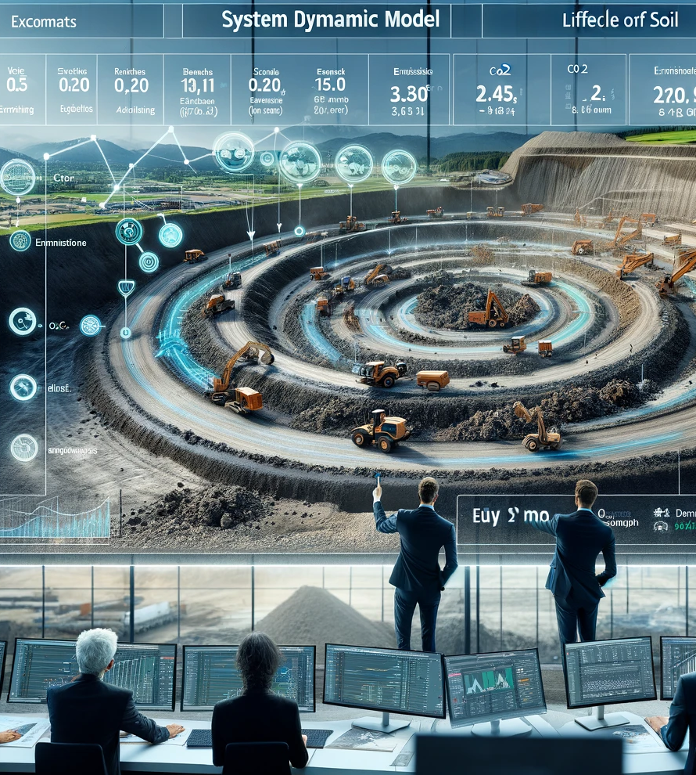
State of 3D Tiles
FOSS4G BE+NL 2024 - Baarle-Nassau, 26-09-2024
Bert Temme
bert.temme@sogelink.com

Slide 2

What is 3D Tiles?
Standard designed for streaming and rendering massive 3D geospatial content:
- Photogrammetry
- 3D Buildings
- BIM/CAD
- Instanced Features
- Point Clouds

Slide 3
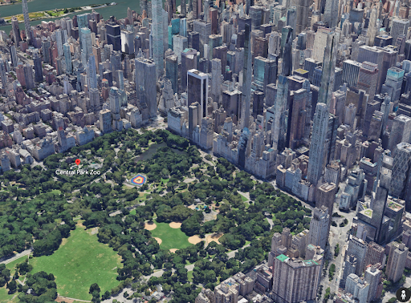
3D Tiles - History
2018: glTF 2.0 by Khronos
2019 - 2021: 3D Tiles 1.0 / 1.1 OGC Community Standard
2023: Google/Esri/(MapBox) supporting 3D Tiles
Last week: Bentley Systems buys Cesium

Slide 4
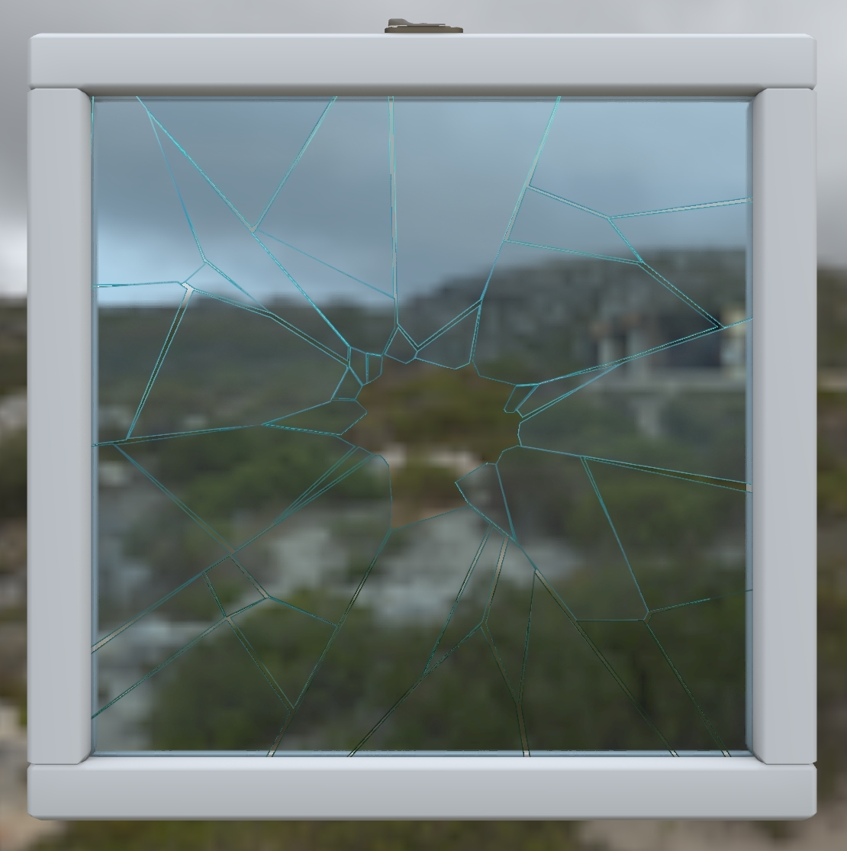
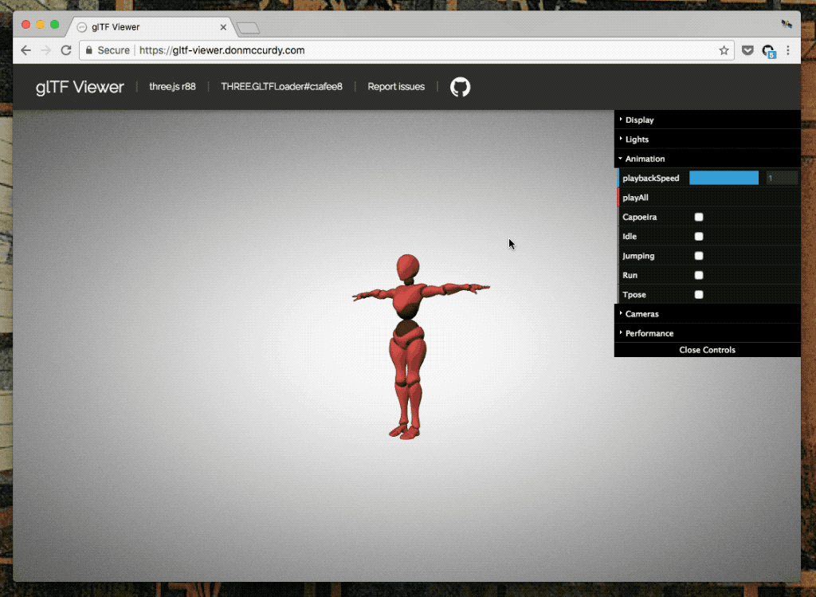
What is glTF?
glTF: Graphics Library Transmission Format
Standard file format for three-dimensional scenes and models.

Slide 5
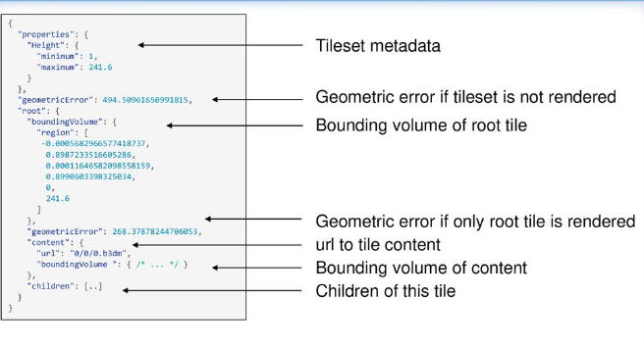
3D Tiles Architecture
1] Tileset.json
2] Tile formats (3D Tiles 1.0)
. Batched (.b3dm)
. Instanced (.i3dm)
. Point Cloud (.pnts)
. Composite (.cmpt)
OR
. GLB in 3D Tiles 1.1

Slide 6
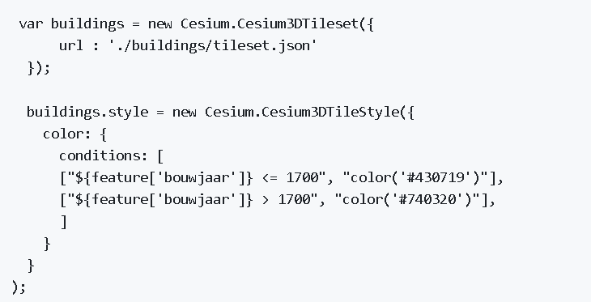
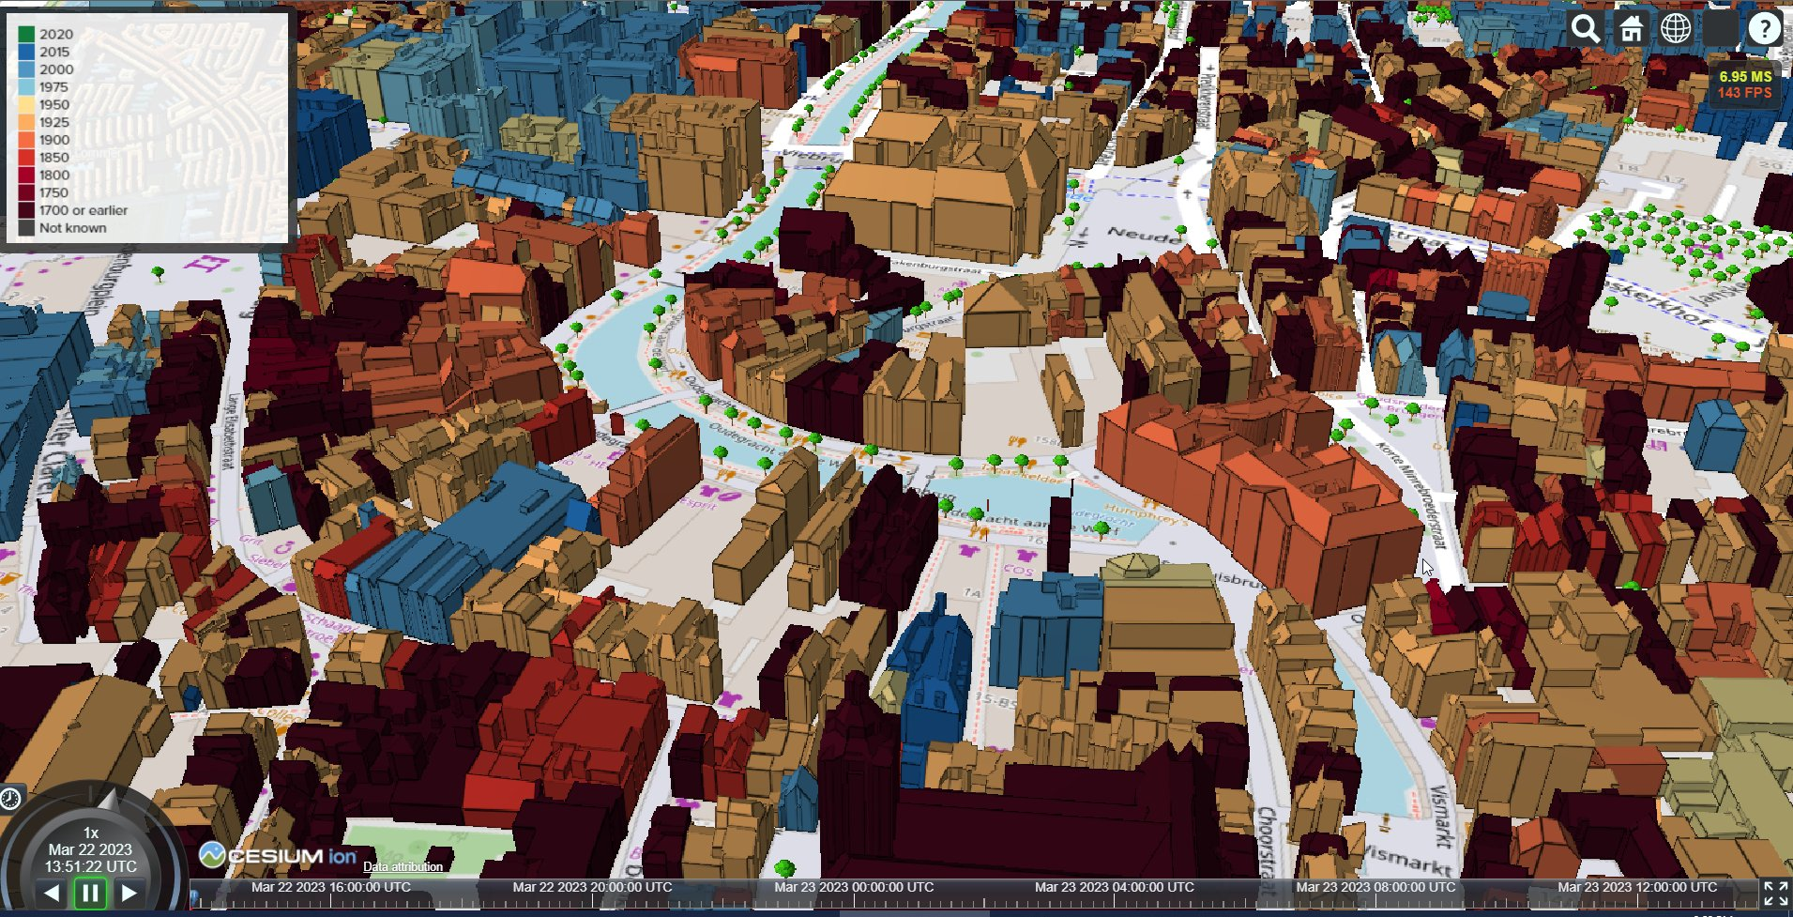
3D Tiles Styling
1] glTF 2.0 Styling
2] 3D Tiles Styling Language

Slide 7
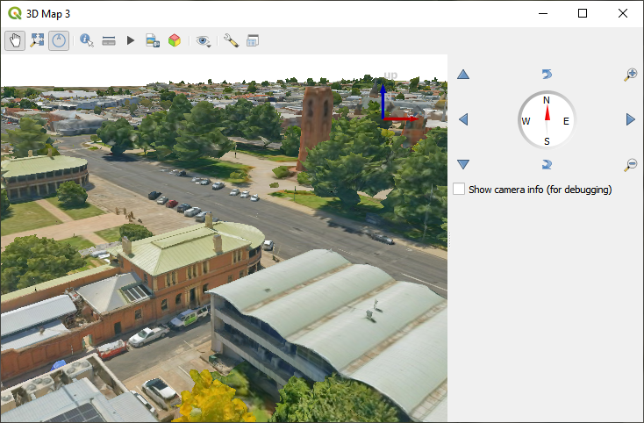
3D Tiles - Ecosystem
1] Tile generators:
FME, Py3DTiles
Pg2b3dm: Create Batched 3D Tiles
I3dm.export: Create Instanced 3D Tiles
2] 3D Tiles clients
Browser: CesiumJS (Leia), 3D Tiles Renderer
Desktop: QGIS, ArcGIS Pro
Game Engines: Unreal, Unity3D, NVidia Omniverse

Slide 8
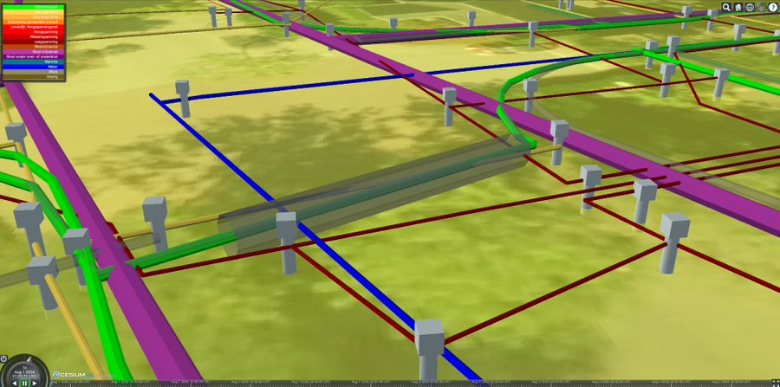
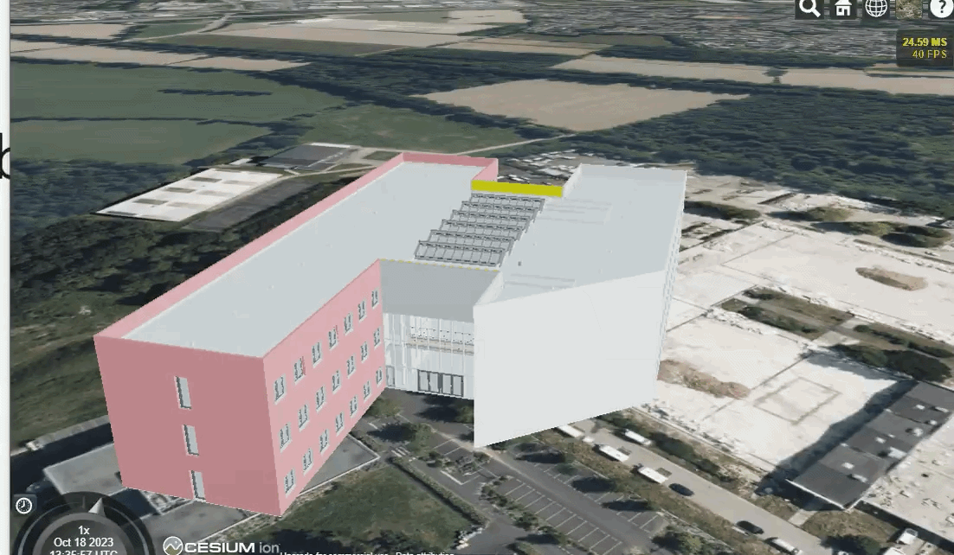
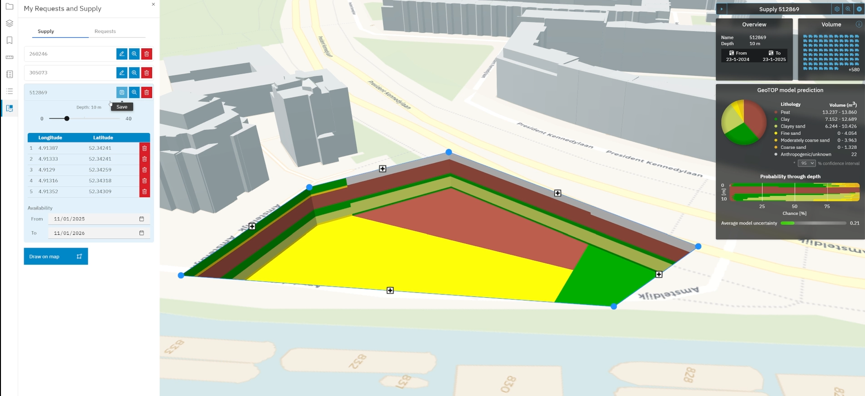
3D Tiles - Samples

Slide 9


3D Tiles – Further reading
1] Geonovum
Handreiking 3D Tiling - https://www.geonovum.nl/themas/digital-twins/3D-tiling
7 november - 3D Tiles Workshop Open Geodag https://www.geonovum.nl/over-geonovum/agenda/open-geodag
2] 3D Tiles Nederland
https://3dtilesnederland.nl/

Slide 10
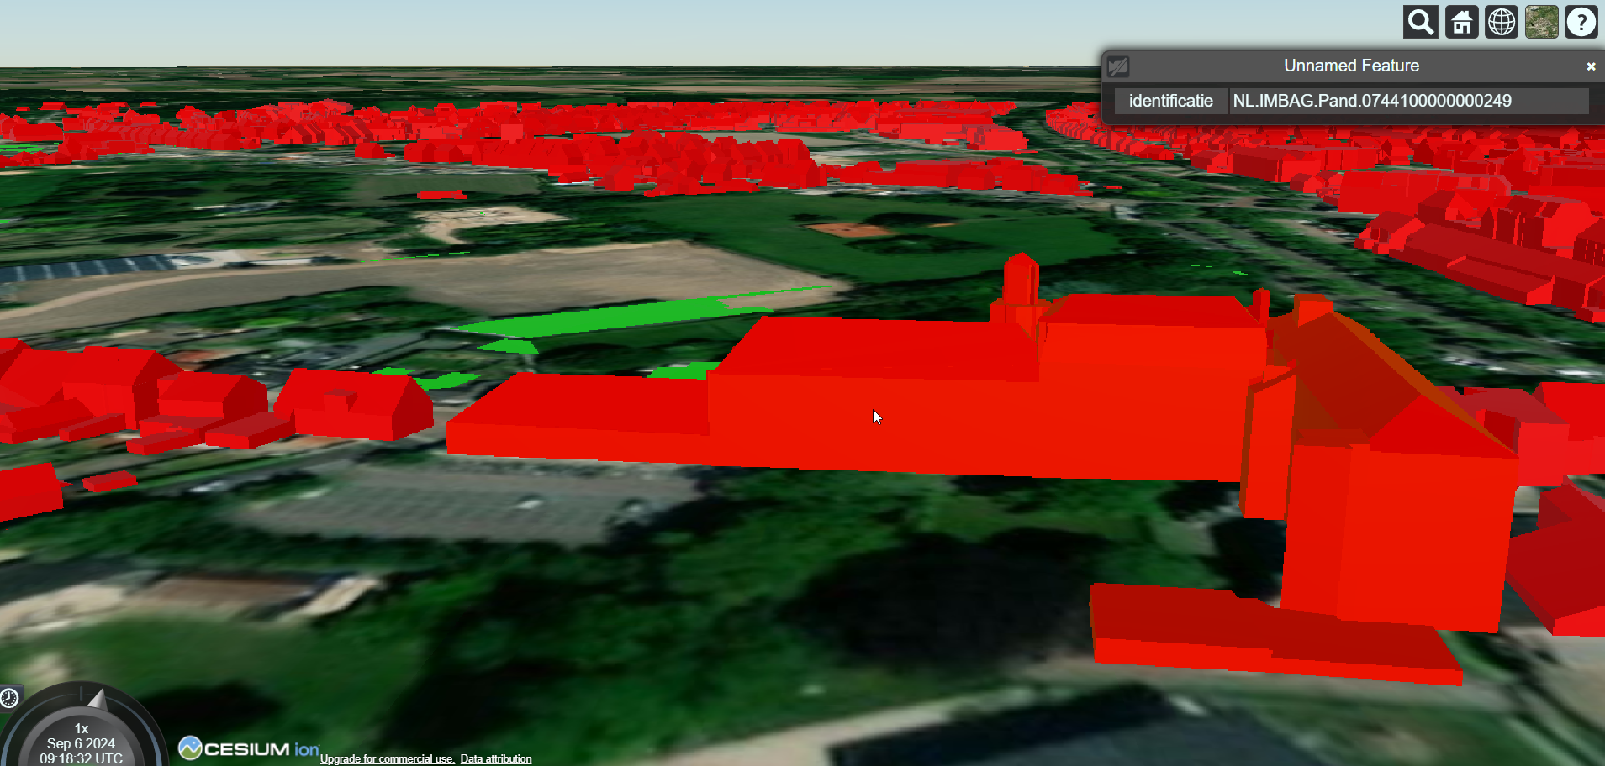
3D Tiles Demo!
Create Digital Twin of Baarle Nassau
Let's start with the buildings....
https://github.com/bertt/baarle_nassau

Slide 11
3D Tiles - Questions
Thanks!
Questions?
bert.temme@sogelink.com

